Slide 1
Auto-self-adjusted provision at resource level
Proposal
Present at 11th of March
You Hu

Slide 2
SAGECal
SAGECal
SAGECal
Pre-processed data
SAGECal
Results
Excon?
Fixed sky model

Slide 3
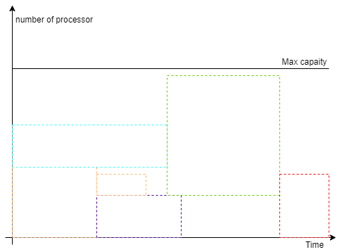
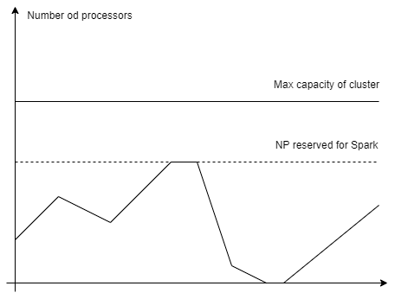
Issues of MPI and Spark
The resources can not be utilized completely

Slide 4
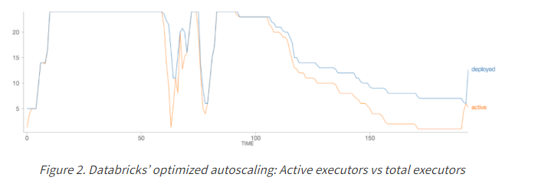
Possible solution?
MPI:
Smart job queue managed by cluster
Finer or uniformed granularity
Spark
Containerization (current solution)
Buy Databricks auto-scaling solution
Other solution?
Kubernetes
VMs

Slide 5
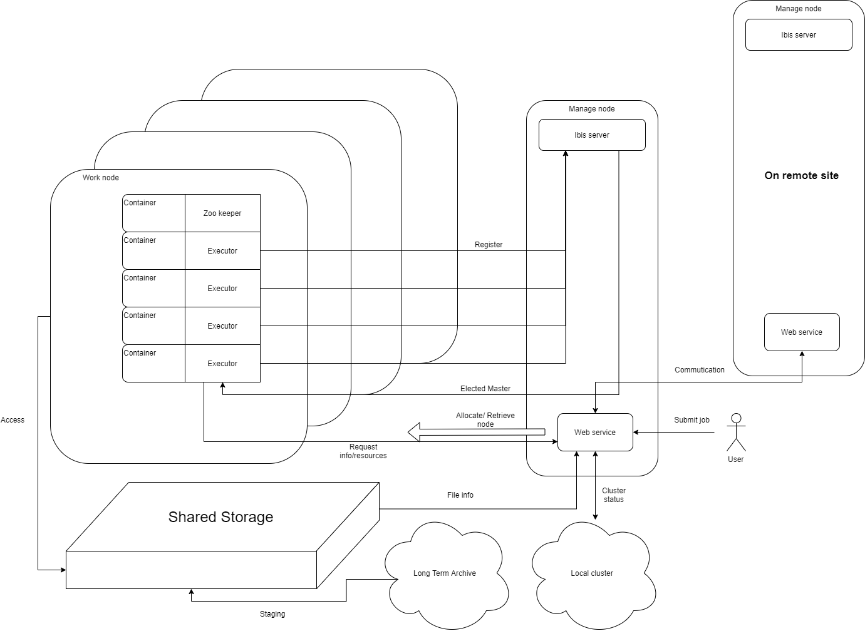
Overview design
Tackle on THREE dimensions
Self-adjusted provisioning
Cross region
Data locality

Slide 6
Self-adjusted provisioning
{job queue:[8,16,16,12,2,32],
Idle nodes: 4,
Request: null,
Release: ”success”
}
Master
Server
{Release: “node33”,
Request: null}
Release

Slide 7
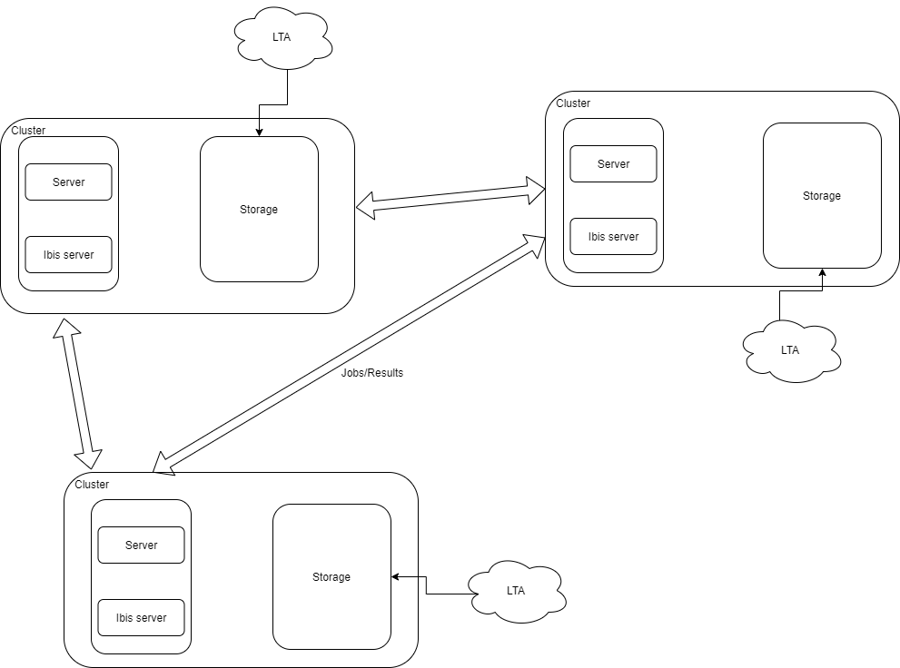
Cross region & Data locality
Utilizing remote resources
Backup to each other
Submit anywhere, run at close place
Staging and processing at same time

Slide 8
Stages plan
Phase 1: Ibis +Sagecal with docker container on one node
Phase 2: resource management at one cluster(multiple nodes)
Phase 3: cross-region
Extra 1: parallelize staging from tape and processing

